Slide 1

myopia data analysis

Slide 2
objective
understand causes of myopia and their prevalence by age group
and risk level.

Slide 3
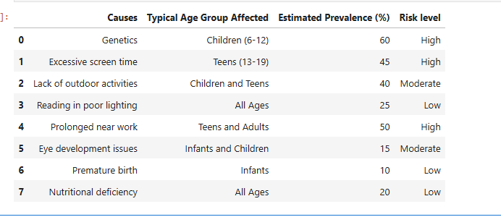
DATASET OVERVIEW

Slide 4

Key findings
Genetics: #1 cause of myopia
Teens /children: Screen time ,low outdoor activity
Infants: Premature birth

Slide 5
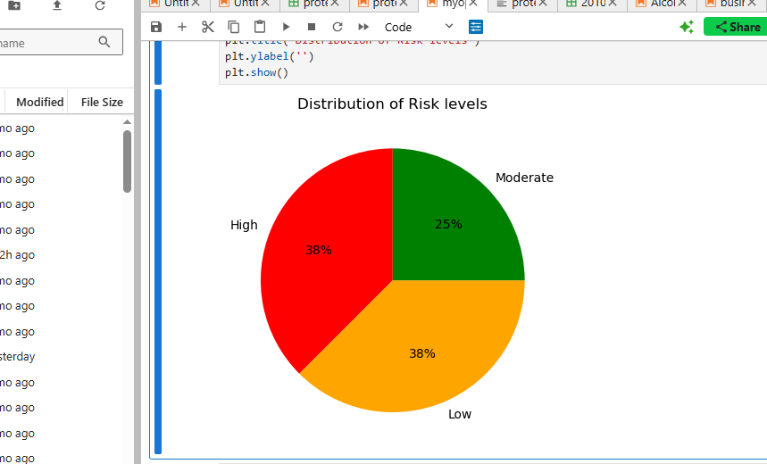
Risk level distribution

Slide 6

recommendations
promote outdoor time
Screen high-risk infants
Integrate family history into checkups

